Slide 1
CHAPTER 6-9:CORE DATA STRUCTURES
COSC 221 (Computer Science B)

Slide 2
Contents
Motivation
Stacks
Queues
Linked Lists
Priority Queues
Applications

Slide 3
Objective
Define and explain the purpose of Stacks, Queues, Linked Lists, and Priority Queues.
Understand and apply the LIFO principle for stacks and the FIFO principle for queues.
Perform basic operations for:
Stacks: push(), pop(), top().
Queues: enqueue(), dequeue(), first().
Linked Lists: Insertion, deletion, traversal.
Priority Queues: insert(), remove_min().

Slide 4
Motivation

Slide 5
Motivation
In computing, we often need to manage data in specific ways:
  Undoing actions or processing tasks in reverse order.
  Managing multiple requests in the order they arrive.
  Efficiently updating and accessing data that changes over time.

Slide 6
Motivation
To address these, we use data structures like:
  Stacks for reversing data (undo operations).
  Queues for processing data in sequence (task scheduling).
  Linked lists for flexible data storage.
  Priority queues for prioritizing tasks based on importance.
These structures help solve common problems and improve program efficiency.

Slide 7
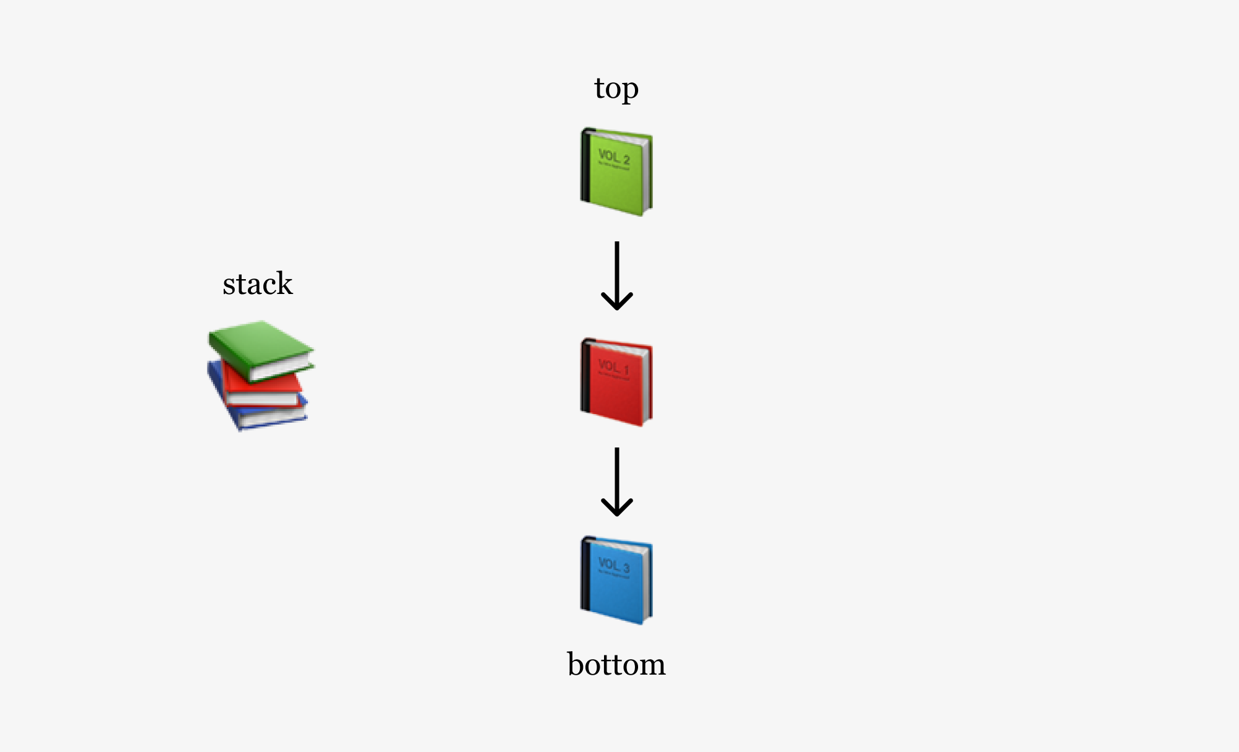
Stacks
A stack is a collection of objects that are inserted and removed according to the last-in, first-out (LIFO) principle.
Important Operations:
push(): Add an object to the top of the stack.
pop(): Remove and return the top object from the stack.
top(): Access (but do not remove) the top object.

Slide 8
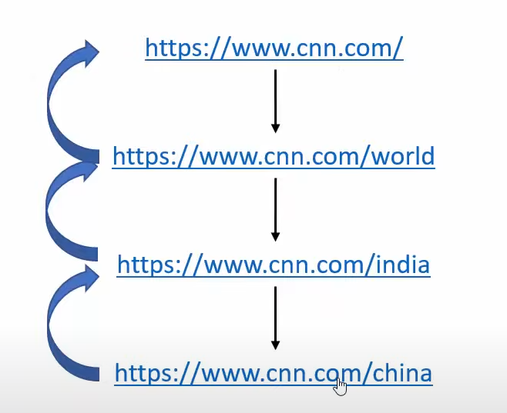
Stacks
Applications of Stacks:
  Problem: How does a browser let you go back to previously visited sites?
  Solution:
    Each time you visit a new site; its address is pushed onto a stack.
    When you click the "back" button, the browser pops the most recent address from the stack.

Slide 9
Stacks
Problem 1: Reversing a String Using a Stack
Steps to Solve:
  Push each character of the string onto the stack.
  Pop each character from the stack to build the reversed string.
Push Phase:
  The string "hello" is iterated character by character.
  Each character (h, e, l, l, o) is pushed onto the stack.
  Stack after pushing: ['h', 'e', 'l', 'l', 'o'] (top is o).

Slide 10

Stacks
Problem 1: Reversing a String Using a Stack
2. Pop Phase:
  Characters are popped from the stack one by one.
  Since the stack is LIFO, the first character popped is o, then l, l, e, and finally h.
  These characters are concatenated to form the reversed string "olleh".
  Task: Write a function that takes the length ‘n’ of a string followed by each of its characters, then return the reversed string.

Slide 11
Stacks
Problem 2: Balancing Parentheses Using a Stack
Problem Statement:
Given a string containing parentheses (), braces {}, and square brackets [], determine if the input string has balanced parentheses. A string is balanced if:
Every opening symbol has a corresponding closing symbol.
The pairs are properly nested.
Example:
Input: {[()()]}
Output: True
Input: {[(])}
Output: False

Slide 12
Stacks
Problem 2: Solution
def is_balanced(expression):
stack = []
# Dictionary to hold matching pairs
matching_pairs = {')': '(', '}': '{', ']': '['}
for char in expression:
if char in matching_pairs.values(): # If it's one of the opening symbols
stack.append(char)
elif char in matching_pairs.keys(): # If it's one of the closing symbols
if stack == [] or stack.pop() != matching_pairs[char]:
return False
return len(stack) == 0
# Test cases
expression1 = "{[()()]}"
expression2 = "{[(])}"
print(is_balanced(expression1)) # Output: True
print(is_balanced(expression2)) # Output: False

Slide 13
Stacks
Challenge 1: Adding More Delimiters
< > (angle brackets)
' ' (single quotes)
" " (double quotes)
Question: How would you modify the matching_pairs dictionary to include these new symbols?
Hint: You would need to update the dictionary

Slide 14
Stacks
Demo

Slide 15
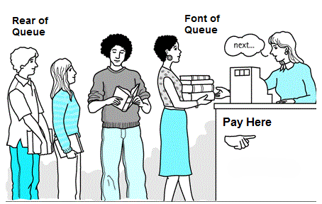
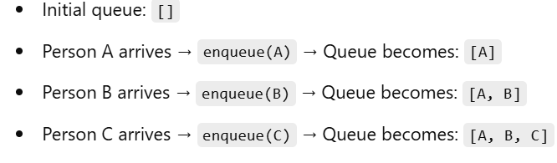
Queues
A queue is a collection of objects that are inserted and removed according to the first-in, first-out (FIFO) principle.
Important Operations:
Q.enqueue(e): Add element e to the back of queue Q.
Q.dequeue( ): Remove and return the first element from queue Q.
Q.first( ): Return a reference to the element at the front of queue Q, without removing it.

Slide 16
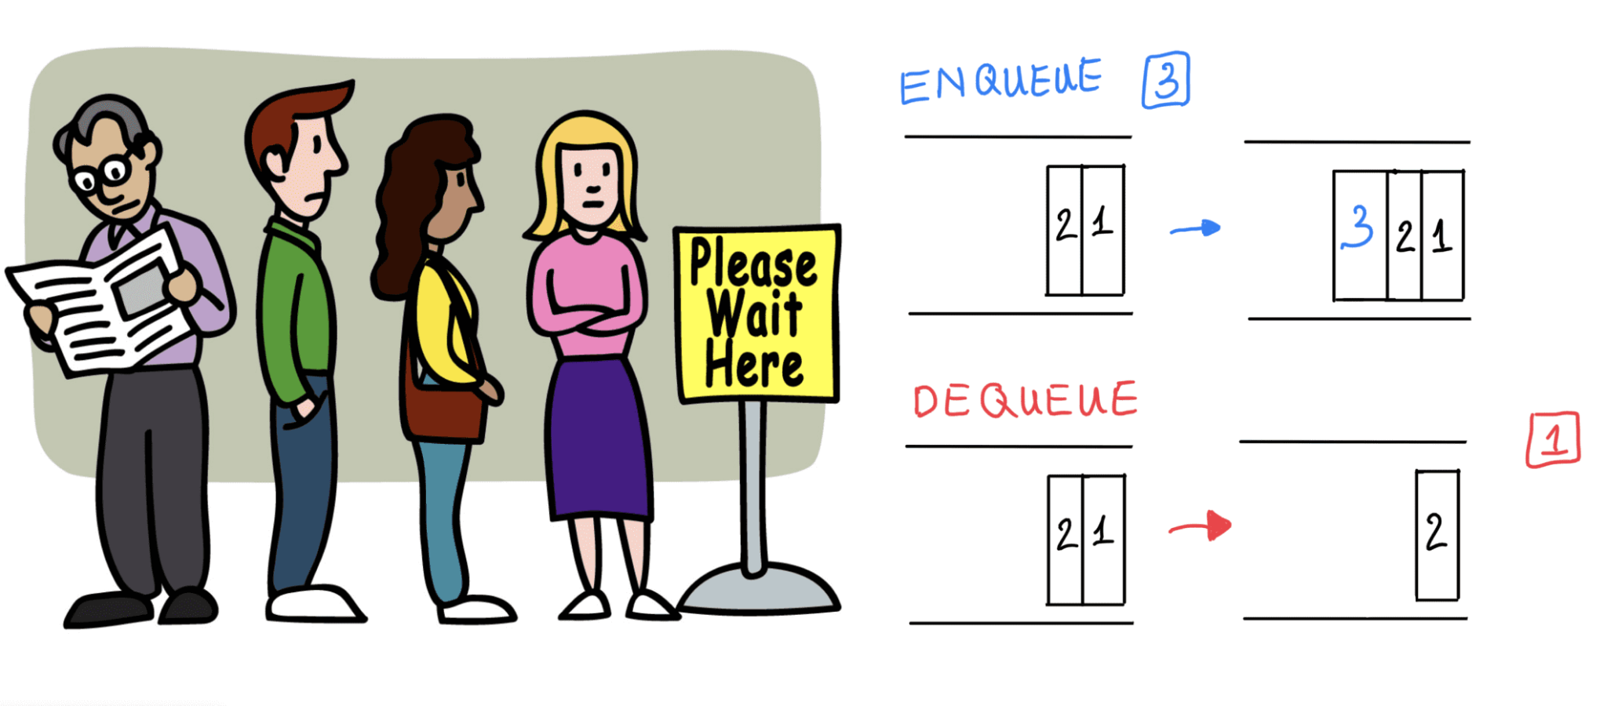
Queues
Applications of Queues:
  Problem: How does a ticket booking system manage customers efficiently?
  Solution:
Customers are served in the order they arrive → FIFO (First In, First Out)
New customers join the queue → Enqueue
The first customer in the queue gets served → Dequeue

Slide 17

Queues
Problem 1: Simulate a queue of people waiting for a service (like at a bank). Each person arrives at the bank and waits for their turn to be served.
Note: Each person has a name and the time they arrive.
Queue Operations:
              enqueue(): A person arrives and joins the queue.
              dequeue(): The person at the front of the queue is served and leaves.
              first(): Check who is next in line.

Slide 18
Queues
Problem 1: Solution
class Queue:
def __init__(self):
self.queue = []
def is_empty(self):
"""Check if the queue is empty"""
return len(self.queue) == 0
def enqueue(self, person):
"""Add person to the back of the queue"""
self.queue.append(person)

Slide 19
Queues
Problem 1: Solution
def dequeue(self):
"""Remove and return the first person in the queue"""
if self.is_empty():
return "No one is in the queue"
return self.queue.pop(0)
def first(self):
"""Return the first person in the queue without removing"""
if self.is_empty():
return "No one is in the queue"
return self.queue[0]

Slide 20
Queues
Problem 1: Solution
# Simulation
queue = Queue()
# Adding people to the queue
queue.enqueue("Alice")
queue.enqueue("Bob")
queue.enqueue("Charlie")
# Checking the first person in the queue
print(f"First in line: {queue.first()}") # Output: Alice
# Serving the first person
served_person = queue.dequeue()
print(f"Served: {served_person}") # Output: Alice
# Checking who is next
print(f"Next in line: {queue.first()}") # Output: Bob

Slide 21
Queues
Demo

Slide 22
Main limitations of Stack & Queues
There are some main limations with Stack and Queue data structure:
  Fixed size: In general (with arrays), stacks and queues are implemented with a fixed size. When it’s full, no more elements can be added, leading to overflow!
  Memory Utilization: With arrays, you need to allocate a contiguous block of memory. It becomes difficult to manage memory efficiently when the size exceeds this block.
  Insertion and deletion: when performed, it requires shifting all elements by 1 position.
  Now, we will have a look at a more flexible data structure…

Slide 23
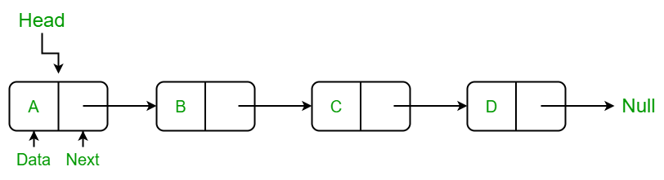
Linked Lists
A linked list is a collection of elements, called nodes, where each node stores two things:
Data: The actual value or information.
Next: A link (or pointer) to the next node in the list
The elements in a linked list are linked using pointers as shown in the below image:
In simple words, a linked list consists of nodes where each node contains a data field and a reference (link) to the next node in the list.

Slide 24
Linked Lists
The "next" helps us know which node comes after the current node, and we keep following the links until we reach None, which tells us the list has ended.
Important Operations of a Linked List:
L.insertFirst(e): Add element e at the beginning.
L.insertLast(e): Add element e at the end.
L.removeFirst(): Remove and return the first element.
L.removeLast(): Remove and return the last element.
L.remove(e): Remove the first occurrence of e.
L.search(e): Return the node with value e, or None if not found.
L.isEmpty(): Return True if list is empty.
L.size(): Return the number of nodes in the list.
L.display(): Print all elements in the list.

Slide 25
Linked Lists
Applications of Linked Lists:
Undo/Redo: Linked list stores previous/next states in software, allowing navigation through actions.
Memory Management: Free memory blocks are managed as nodes, with dynamic allocation and deallocation.
Music Playlist: Linked list stores songs, allowing easy forward/backward navigation.
Browser History: Stores visited pages as nodes, enabling backward/forward navigation.

Slide 26
Linked Lists
Problem 1:Music Playlist (Linked List)
This simple playlist system can easily be extended to manage a collection of songs where you can add songs dynamically and play them one by one, just like in music apps such as Spotify or Apple Music.
1. Problem: Write a class SongNode with song_name data and next method, and wite a class Playlist to organize a playlist of songs in a way that songs can be added dynamically and played in sequence.
2. Concept: A linked list stores songs where each song is linked to the next song in the sequence.
3. Key Operations of Playlist class:
Add Song: Insert new songs at the end of the playlist (linked list).
Play Next: Play and remove the first song, then move to the next one.

Slide 27
Linked Lists
Demo

Slide 28
Priority Queues
A Priority Queues is an abstract data type (ADT) that stores elements along with their priorities. Unlike a regular queue (FIFO), a priority queue removes elements based on their priority, not their insertion order.
Each element in a priority queue is stored as a key-value pair (k, v):
Key (k): Represents the priority (lower key → higher priority).
Value (v): The actual data associated with the key.
The element with the smallest key is dequeued first.

Slide 29
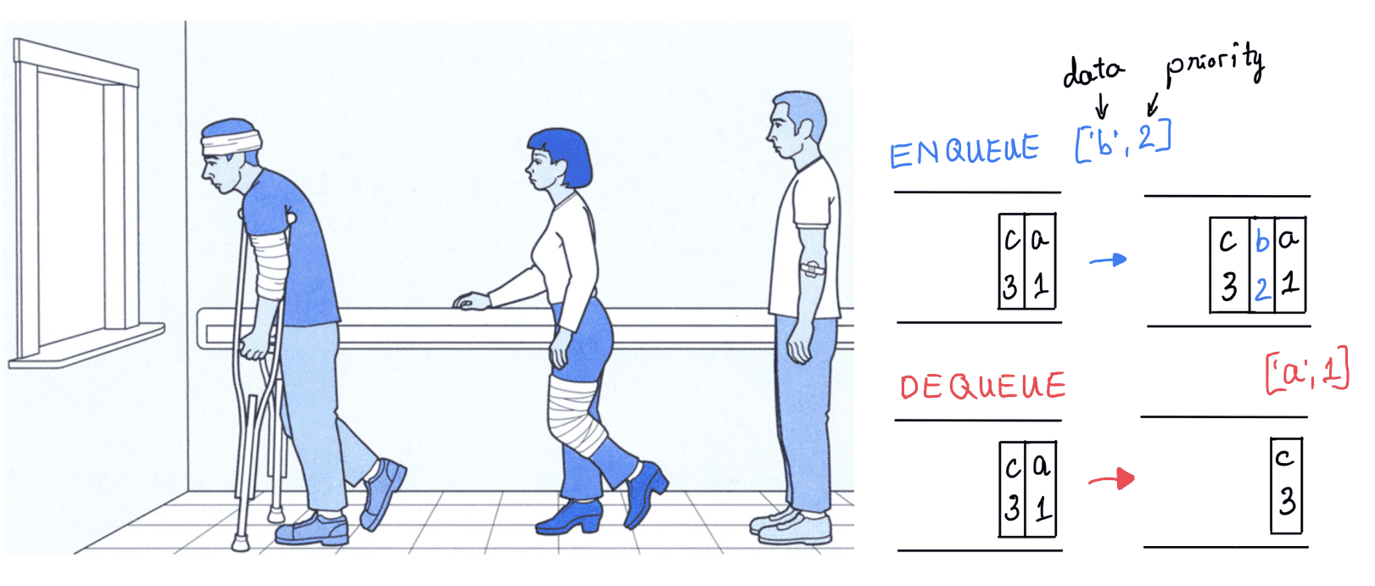
Priority Queues
Important Operations:
add(k, v): Inserts an item with key k and value v
min(): Returns the item (k, v) with the smallest key without removing it
remove_min(): Removes and returns the item (k, v) with the smallest key

Slide 30
Priority Queues
Applications of Priority Queues:
  Problem: How does an air-traffic control system manage landing priority efficiently?
  Solution:
Planes are prioritized based on urgency rather than arrival order.
Factors affecting priority:
Distance from the runway
Time spent in holding pattern
Remaining fuel level
The plane with the highest priority is cleared for landing first.

Slide 31

Priority Queues
Example:
Simulate a queue of people waiting for a service (like at a bank). Each person arrives at the bank and waits for their turn to be served.
Modify the program to include priority. For example, VIP customers should be served first.

Slide 32
Priority Queues
Demo

Slide 33


Q & A
Lecture-Code:
  13.1 - 13.7

